Slide 1


<Zairui Zhang>
<21/01/24>

Slide 2

Outline
Executive Summary
Introduction
Methodology
Results
Conclusion
Appendix

Slide 3
Executive Summary
Summary of methodologies
Data Collection through API
Data Collection with Web Scraping
Data Wrangling
Exploratory Data Analysis with SQL
Exploratory Data Analysis with Data Visualization
Machine Learning
Summary of all results
Exploratory Data Analysis result
Interactive analytics in screenshots
Predictive Analytics result

Slide 4
Introduction
Project background and context
we will predict if the Falcon 9 first stage will land successfully. SpaceX advertises Falcon 9 rocket launches on its website with a cost of 62 million dollars; other providers cost upward of 165 million dollars each, much of the savings is because SpaceX can reuse the first stage. Therefore if we can determine if the first stage will land, we can determine the cost of a launch. This information can be used if an alternate company wants to bid against SpaceX for a rocket launch. It will collect and make sure the data is in the correct format from an API.
Problems you want to find answers
What will lead the rocket land successful?
What operating conditions need to be in place to ensure a successful landing plan?
What features play a key role to determine it success?

Slide 5

Section 1

Slide 6
Methodology
Executive Summary
Data collection methodology:
For this part we use web scraping from Wikipedia and follows SpaceX Api
Perform data wrangling
Using one-hot encoding to categorical features
Perform exploratory data analysis (EDA) using visualization and SQL
Perform interactive visual analytics using Folium and Plotly Dash
Perform predictive analysis using classification models
How to build, tune, evaluate classification models

Slide 7
Data Collection
SpaceX API
Json format to dataframe
Data request
Static response object
Using SpaceX API request and web scraping from Wikipedia to get data
Web scraping records
BeautifulSoup to get tables
Parse data
Convert to dataframe

Slide 8
Data Collection – SpaceX API
SpaceX API
Data request
Get json object
Convert json to dataframe
Filter df to Falcon9 launches
Deal with missing values
https://github.com/jerryzzr/IBM-data-science

Slide 9
Data Collection - Scraping
Web scraping from Wikipedia
Parse table
Convert it to dataframe
BeautifulSoup get data
https://github.com/jerryzzr/IBM-data-science

Slide 10
Data Wrangling
Handle missing values
Occurrence of orbit
Identify column types
Calculate number of launches on each site
https://github.com/jerryzzr/IBM-data-science

Slide 11
EDA with Data Visualization
https://github.com/jerryzzr/IBM-data-science
Catplot
Visualize the relationship between Flight Number and Launch Site
Visualize the relationship between Payload and Launch Site
Visualize the relationship between FlightNumber and Orbit type
Visualize the relationship between Payload and Orbit type
Bar chart
Visualize the relationship between success rate of each orbit type
Line chart
Plot a line chart with x axis to be the extracted year and y axis to be the success rate

Slide 12
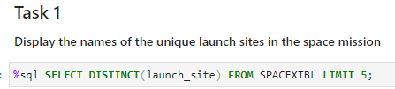
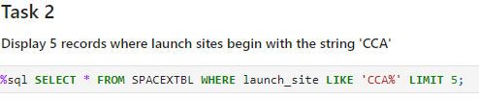
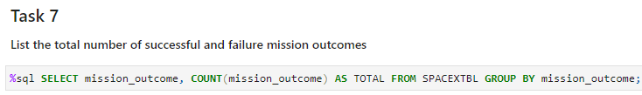
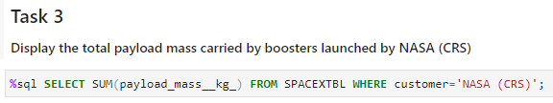
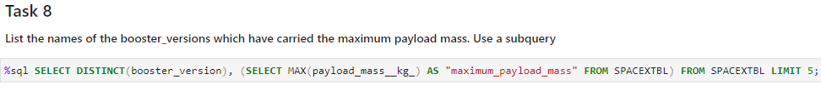
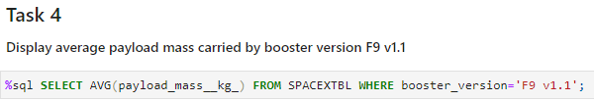
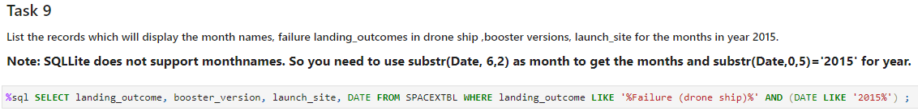
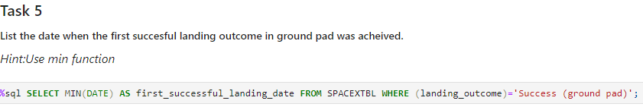
EDA with SQL
https://github.com/jerryzzr/IBM-data-science
For this part I use PostgreSQL performs different task:

Slide 13
Build an Interactive Map with Folium
https://github.com/jerryzzr/IBM-data-science

Slide 14
Build a Dashboard with Plotly Dash
https://github.com/jerryzzr/IBM-data-science

Slide 15
Predictive Analysis (Classification)
https://github.com/jerryzzr/IBM-data-science
Firstly, Load data and transform data. Then split it into train and test set
After prepare, we use different classification methods and compare their performance
tune different hyperparameters using GridSearchCV
Accuracy score comparison

Slide 16
Results
Exploratory data analysis results
Interactive analytics demo in screenshots
Predictive analysis results

Slide 17

Section 2

Slide 18
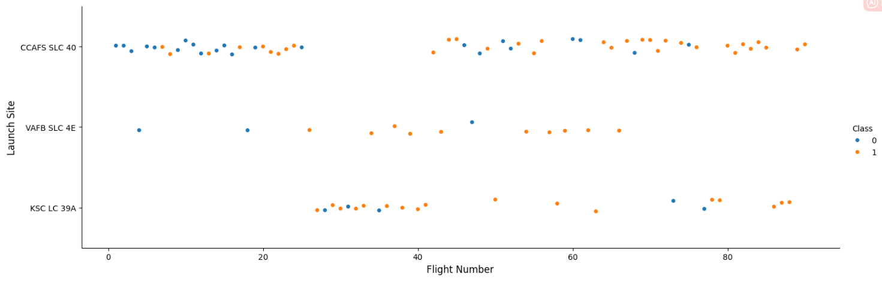
Flight Number vs. Launch Site
Show a scatter plot of Flight Number vs. Launch Site
CCAFS SLC 40 launches more times than the other two sites.
VAFB SLC 4E and KSC LC 39 shows much success than CCAFS SLC 40 but the sample is limited.

Slide 19
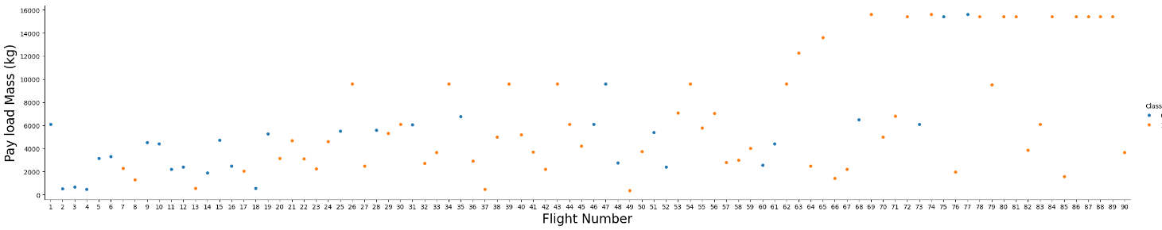
Payload vs. Launch Site
Show a scatter plot of Payload vs. Launch Site

Slide 20
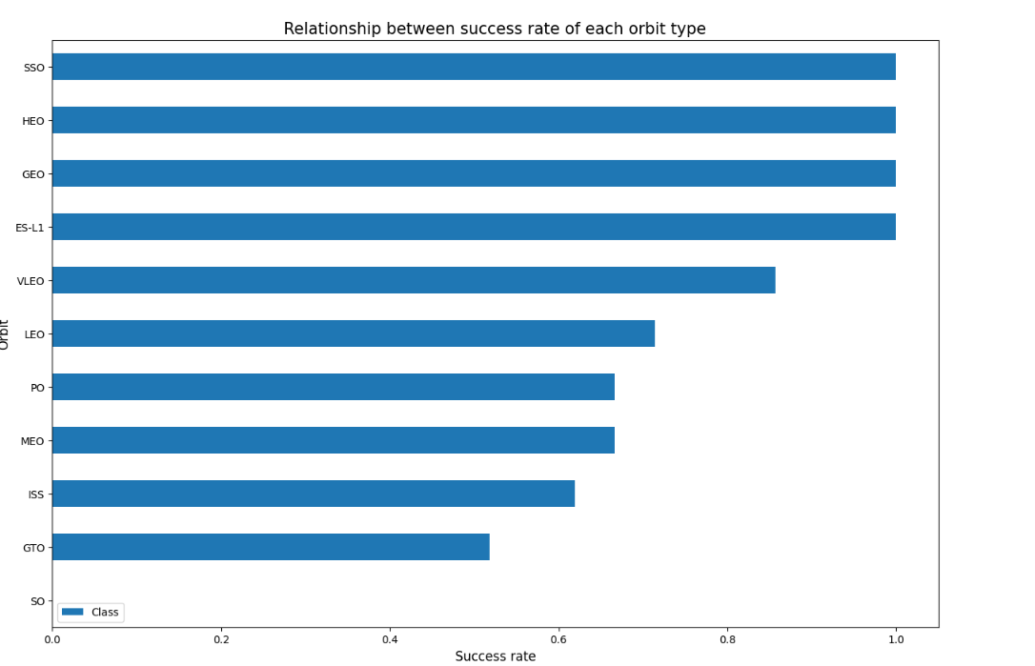
Success Rate vs. Orbit Type
Show a bar chart for the success rate of each orbit type

Slide 21
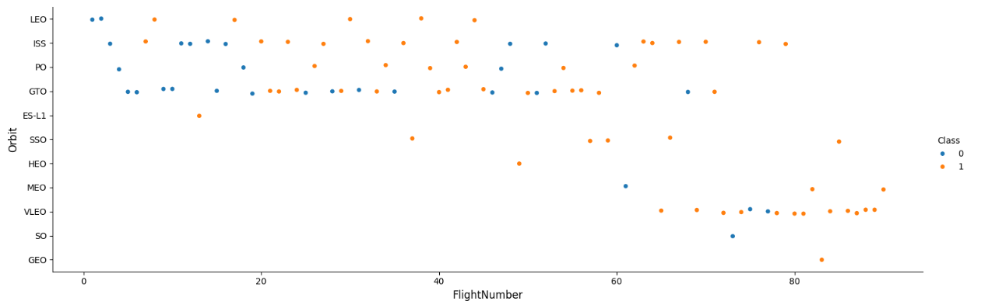
Flight Number vs. Orbit Type
Show a scatter point of Flight number vs. Orbit type
We can observe that VLEO has a higher success rate when flightnumber increase

Slide 22
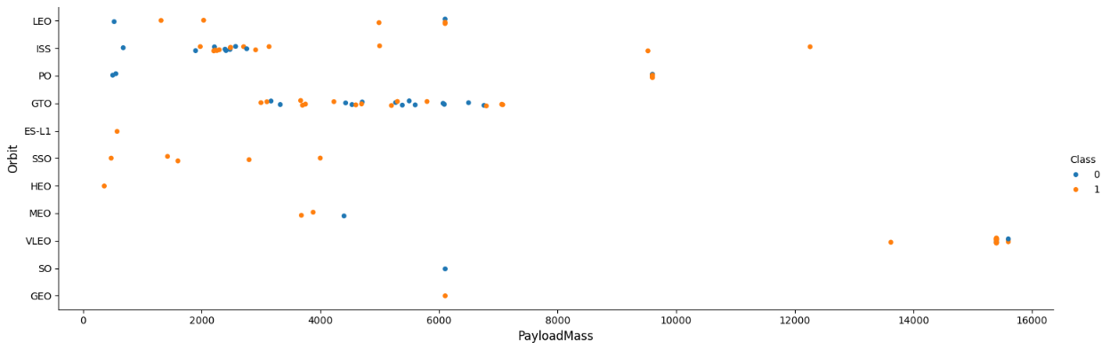
Payload vs. Orbit Type
Show a scatter point of payload vs. orbit type
More payloads, the successful landing are more for PO, LEO and ISS orbits. SSO always success.

Slide 23
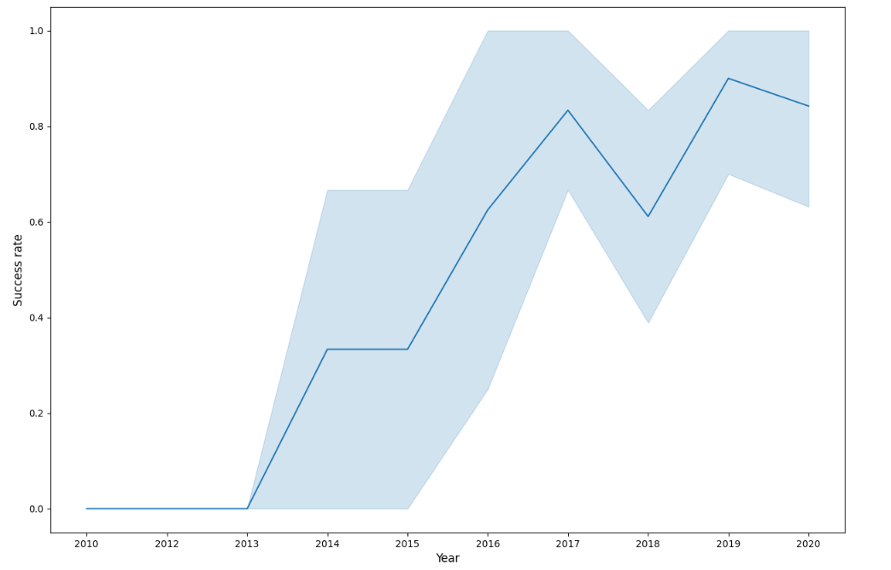
Launch Success Yearly Trend
Show a line chart of yearly average success rate
Rate from 2013 increase till 2020.

Slide 24
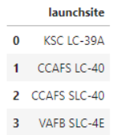
All Launch Site Names
Find the names of the unique launch site

Slide 25
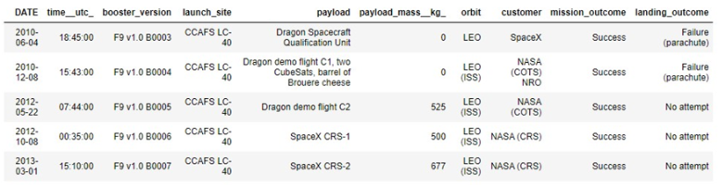
Launch Site Names Begin with 'CCA'
Find 5 records where launch sites begin with `CCA`
Present your query result with a short explanation here

Slide 26
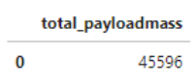
Total Payload Mass
Calculate the total payload carried by boosters from NASA

Slide 27
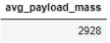
Average Payload Mass by F9 v1.1
Calculate the average payload mass carried by booster version F9 v1.1

Slide 28
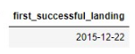
First Successful Ground Landing Date
Find the dates of the first successful landing outcome on ground pad

Slide 29
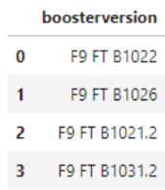
Successful Drone Ship Landing with Payload between 4000 and 6000
List the names of boosters which have successfully landed on drone ship and had payload mass greater than 4000 but less than 6000

Slide 30
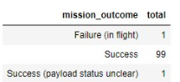
Total Number of Successful and Failure Mission Outcomes
Calculate the total number of successful and failure mission outcomes

Slide 31
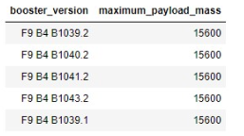
Boosters Carried Maximum Payload
List the names of the booster which have carried the maximum payload mass

Slide 32
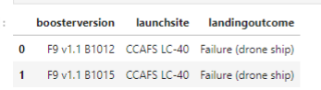
2015 Launch Records
List the failed landing_outcomes in drone ship, their booster versions, and launch site names for in year 2015

Slide 33
Rank Landing Outcomes Between 2010-06-04 and 2017-03-20
Rank the count of landing outcomes (such as Failure (drone ship) or Success (ground pad)) between the date 2010-06-04 and 2017-03-20, in descending order
Present your query result with a short explanation here

Slide 34

Section 3

Slide 35
<Folium Map Screenshot 1>
Replace <Folium map screenshot 1> title with an appropriate title
Explore the generated folium map and make a proper screenshot to include all launch sites’ location markers on a global map
Explain the important elements and findings on the screenshot

Slide 36
<Folium Map Screenshot 2>
Replace <Folium map screenshot 2> title with an appropriate title
Explore the folium map and make a proper screenshot to show the color-labeled launch outcomes on the map
Explain the important elements and findings on the screenshot

Slide 37
<Folium Map Screenshot 3>
Replace <Folium map screenshot 3> title with an appropriate title
Explore the generated folium map and show the screenshot of a selected launch site to its proximities such as railway, highway, coastline, with distance calculated and displayed
Explain the important elements and findings on the screenshot

Slide 38

Section 4

Slide 39
<Dashboard Screenshot 1>
Replace <Dashboard screenshot 1> title with an appropriate title
Show the screenshot of launch success count for all sites, in a piechart
Explain the important elements and findings on the screenshot

Slide 40
<Dashboard Screenshot 2>
Replace <Dashboard screenshot 2> title with an appropriate title
Show the screenshot of the piechart for the launch site with highest launch success ratio
Explain the important elements and findings on the screenshot

Slide 41
<Dashboard Screenshot 3>
Replace <Dashboard screenshot 3> title with an appropriate title
Show screenshots of Payload vs. Launch Outcome scatter plot for all sites, with different payload selected in the range slider
Explain the important elements and findings on the screenshot, such as which payload range or booster version have the largest success rate, etc.

Slide 42

Section 5

Slide 43
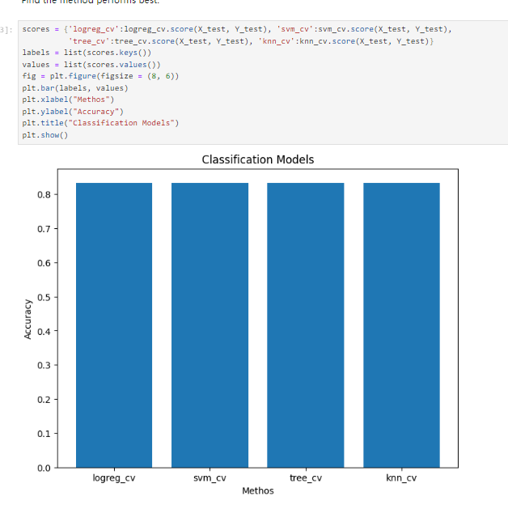
Classification Accuracy
They all have similar score after compare the accuracy from the boxplot. But for exactly number, Decision tree is a litter better method.

Slide 44
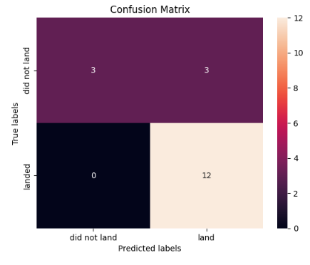
Confusion Matrix
Show the confusion matrix of the best performing model with an explanation

Slide 45
Conclusions
When increasing flight times of one site, it will increase the success rate for that site.
After comparison, decision tree has a better accuracy as a classification method to learn the model
Launch success rate from 2013 increase till 2020.

Slide 46
Appendix
Include any relevant assets like Python code snippets, SQL queries, charts, Notebook outputs, or data sets that you may have created during this project

Slide 47


